Slide 1
TU856-1 & TU858-1 Computer Architecture and Technology Module Code: CMPU 1006
Semester 1, Week 3
COMPUTERS AND ELECTRICITY

Slide 2
Presentation Outline
This presentation is a thorough examination of the principles of the functions of electronic circuits in relation to the nature of electricity.
It will begin by describing how electricity flows – at the subatomic level.
There are examples of electric circuits of microelectronic devices, which relate to computers directly.

Slide 3
Presentation Content - including
Energy for Computers
Electricity
Current
Voltage
Circuits
Ohm’s Law
Power
Digital Circuits
Resistors
Capacitors
Input / Output Devices
Field Effect Transistors
Lecture Summary
Where to Next?

Slide 4
The Topics
Electricity – its properties and how it is measured.
Electronic circuits – in relation to hardware architecture.
Electronic components – in relation to hardware architecture.

Slide 5
Energy for Computers
Computers are physical devices and so need physical energy with which to operate.
ELECTRICITY is a form of energy.
Electricity is a useful means of powering many physical devices - including computers - because it is predictable and manageable…
… and fairly easy to generate.

Slide 6
Energy for Computers (2)
Electricity needs to be understood in terms of science – the science of physics.
With physics the power (energy) can be managed and, through engineering, made to be predictable.
The science of physics takes the best view of energy at an atomic – or sub-atomic – level.

Slide 7
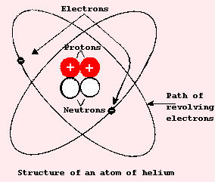
The Atom
All matter is made of atoms that are combined together into molecules.
The atom is composed of protons, neutrons and electrons.
Protons have a positive charge
Electrons have a negative charge
Neutrons are neutral

Slide 8
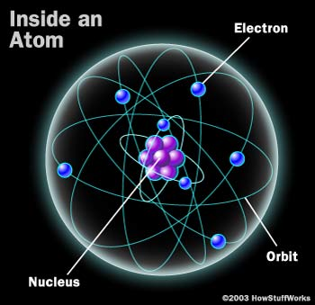
Electricity
Electricity starts with electrons. Every atom contains one or more electrons. Electrons have a negative charge.
Model of an atom

Slide 9
Electricity (2)
In many materials, the electrons are tightly bound to the atoms. Wood, glass, plastic, ceramic, air, cotton ...
These are all examples of materials in which electrons stick with their atoms.
Because the electrons do not move these materials cannot conduct electricity very well, if at all. These materials may act as electrical insulators.

Slide 10
Electricity (3)
While elements and compounds of various densities will insulate electricity, most metals have electrons that can detach from their atoms and move around.
These are called free electrons.
Gold, silver, copper, aluminum, iron, etcetera all have free electrons. The loose electrons make it easy for electricity to flow through these materials, so they are known as electrical conductors.
They conduct electricity. The moving electrons transmit electrical energy from one point to another.

Slide 11
Electrical Charge
Electric field surrounds every charged particle that can exert force on other charged particles.
Field strength is the same for every electron and proton, with a magnitude of one “fundamental unit” of:
1.602 x 10⁻¹⁹ Coulombs.
A coulomb is a measure of charge of electric current. One coulomb of charge is transferred through a conductor by one ampere of current in one second.
To give scale; one coulomb of charge flows through a 120 Watt lightbulb in one second.

Slide 12
Current
In an electrical circuit the number of electrons that are moving is called the amperage or the current.
Current is measured in amps. (Short for the proper term, ‘ampere’.)
In terms of movement, one amp is equal to one ‘coulomb’ per second.
The ‘pressure’ pushing the electrons along is called the voltage and is measured in volts.

Slide 13
Voltage
Voltage example:
1 amp at 6 volts.
1 amp physically means that 6.24 x 10¹⁸ electrons move through a wire every second.
One amp is the number of electrons moving,
and the voltage is the amount of pressure behind those electrons.

Slide 14
Voltage (2)
A positive electric field around a group of protons will exert a repelling force on other groups of protons, and an attracting force on groups of electrons.
The amount of energy an electric field can impart to unit of charge is measured in joules per coulomb, also known as voltage.
Voltage is used as a short name for ‘electrical potential difference’.

Slide 15
Voltage (3)
Moving electrons have energy. As the electrons move from one point to another, they can do work.
I.E. Since an electric field can cause charged particles to move, it can do some amount of work, and so it is said to have electrical potential energy.
The source of electricity has a positive terminal and a negative terminal.
The source will naturally push electrons out of its negative terminal at a certain voltage.

Slide 16
Circuits
The word, ‘circuit’ derives from the fact that electric power is shown in diagrams flowing from the positive terminal of a power source, through one or more electronic device, and back to the negative terminal of a power source, thereby forming a circuit.
The electrons will need to flow from the negative terminal to the positive terminal through a wire or some other conductor. When there is a path that goes from the negative to the positive terminal, you have a circuit, and electrons can flow through the wire.

Slide 17
Circuits (2)
Did you spot it – the ‘deliberate mistake’ on the previous slide?
Are those ‘positives’ and ‘negatives’ mixed up?
Those TEXTBOOKS can be so confusing on this! Watch out for that – and many similar things in electro-mechanical physics!

Slide 18
Circuits (3)
Electrical circuits can get quite complex. But at the simplest level, you always have the source of electricity (a battery, etc.), a load (a light bulb, motor, etc.), and two wires to carry electricity between the battery and the load.
Electrons move from the source, through the load and back to the source.

Slide 19
Circuits (4)
Assume this circuit has an energy source – you will see a switch breaking or completing the circuit to allow the electrons to move. The ‘load’ is the filament of the light bulb. The energy causes it to heat up and give off light.
Open
Closed
circuit
circuit

Slide 20
Circuits (5)
If the connections between an electronic device and either the positive or negative terminals of a power supply are interrupted, the circuit will be broken and the device will not function.
Components in a circuit are connected to one another by means of electrical conductors or wires – including components such as resistors, capacitors, diodes, transistors, etc…

Slide 21
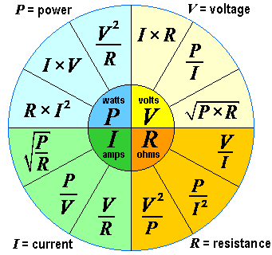
Resistance
All materials, including conductors, exhibit some amount of resistance to the flow of electric current. The amount of resistance determines how much current can flow – the higher the resistance, the less current can flow.
Notes:
Electrons carry the smallest possible amount of negative charge, and billions of them are present in even the tiniest piece of matter.
Insulators - electrons are held firmly in place by heavier, positively charged protons. Electrons cannot move freely between atoms.
Conductors - electrons can move more easily from atom to atom.
The movement of electrons in a conductor is called electric current, measured in amperes.
If a power supply is used to impress a voltage across a conductor, electrons will move from the negative side of the supply through the conductor towards the positive side.
All materials, even conductors, exhibit some amount of resistance to the flow of electric current. The amount of resistance determines how much current can flow – the higher the resistance, the less current can flow.
A conductor has very low resistance, so a conductor by itself would never be placed across a power supply because far too much current would flow, damaging either the supply or the conductor itself. Rather an electronic component called a resistor would be used in series with the conductor to limit current flow.

Slide 22
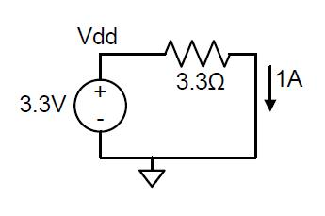
Ohm’s Law
In 1825 Georg Ohm demonstrated through a series of experiments that voltage, current and resistance are related through a fundamental relationship.
Voltage (V) is equal to Current (I) times resistance (R), or V = I·R.
Resistance is measured in ohms, with the ‘Omega’ symbol Ω.
One volt impressed across 1 ohm of resistance will cause 1 amp of current to flow (and one coulomb of charge will pass through the resistor in one second).
Similarly, 3.3V impressed across 3.3 Ω will cause 1A (1 amp) of current to flow.

Slide 23
Power
Collisions occur between the electrons flowing from the power supply and the materials in the conductor when current flows through it.
These collisions cause electrons to give up their potential energy, and that energy is dissipated as heat.

Slide 24
Power (2)
In electric circuits, power, measured in watts, is defined as (voltage x current) or P = V·I.
The power transferred to the resistor at any given time results in resistor heating. The more power transferred to the resistor, the hotter it gets.
For a given voltage, a smaller-valued resistor would allow more current to flow (see Ohm’s Law), and therefore, more energy would be dissipated as heat (so the conductor would get hotter).
Notes:
As current flows through the resistor, collisions occur between the electrons flowing from the power supply and the materials in the resistor.
The total energy consumed in an electric circuit is simply the time integral of power, measured in Watts per second, or Joules. Thus, in the circuit above, the electric power delivered to the resistor is P = 3.3V x 1A, or 3.3Watts and in one second, 3.3W x 1second or 3.3J of energy is dissipated.

Slide 25
Energy
The total energy consumed in an electric circuit is simply the time integral of power, measured in Watts per second, or Joules.
Thus, in the circuit below, the electric power delivered to the resistor is P = 3.3V x 1A, or 3.3Watts
In one second, 3.3W x 1 second or 3.3J of energy is dissipated.

Slide 26
Component Power
Electrical devices need to be engineered as, for example, some parts of the computer requires high power and others require low power:
Disk drive @ 12 volts
Processor : 0.5 – 0.9 volts

Slide 27
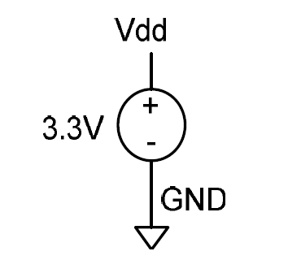
Power Supply in Digital Circuits
In a digital circuit power supply voltage levels are constrained to two distinct values:
“Logic High Voltage” (called LHV or Vdd) and
“Logic Low Voltage” (called LLV or GND).
Vdd may be thought of as source of positive charge while GND source of negative charge in a circuit.
GND net in any circuit is the universal reference voltage against which all other voltages are measured.
Any nodes labelled GND in a schematic are assumed to be connected into the same node. Often, a downward pointing triangle symbol is attached to a GND node in addition to (or instead of) the GND label.
Vdd node in a digital circuit is typically the highest voltage.
All nodes labelled Vdd are tied together into the same node.
Notes:
Vdd may be thought of as the “source” of positive charges in a circuit, and GND may be thought of as the “source” of negative charges in a circuit.
In modern digital systems, Vdd and GND are separated by anywhere from 1 to 5 volts. Older or inexpensive circuits typically use 5 volts, while newer circuits use 1-3 volts.

Slide 28
Power Supply in Digital Circuits (2)
Vdd? … GND? …
These terms are old references to old circuit features that carried on into the microchip era.
The ‘V’ reminds the engineer that we are dealing with voltage, the dd (or DD) represents ‘Drains’. Why two? I THINK it is to denote drain in the plural.
GND – ‘Ground’, and it is attached to the negative terminal. You might see voltage notation, ‘Vss’ associated with GND. (Vss for ‘sources’).

Slide 29
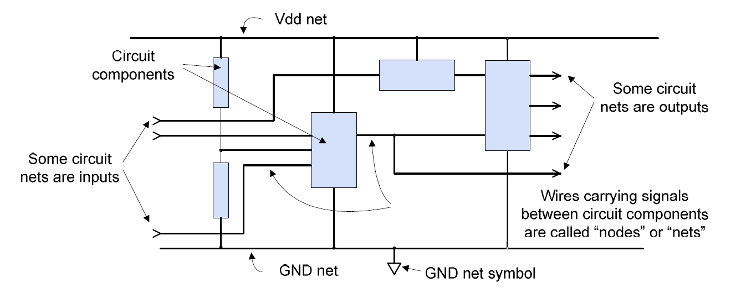
Digital Circuits

Slide 30
Digital Circuits (2)
A digital circuit is constructed of a power supply, devices, and conduction nets.
Some nets provide circuit inputs from the “outside world”; in a schematic, these input nets are generally shown entering the left side of component and/or the overall circuit.
Other nets present circuit outputs to the outside world; these nets are generally shown exiting the schematic on the right.
In the shown schematic, circuit components are shown as arbitrary shapes, nets are shown as lines, and inputs and outputs are denoted by connector symbols.

Slide 31
Digital Circuits (3)
A digital circuit requires a power supply to provide a constant and stable source of electric power to all devices. A “power supply” in a digital circuit provides a local, contained imbalance of electrons that provides a voltage source that can do useful work, such as transmitting information through a conductor from one device to another.
A digital circuit allows a controlled flow of electrons from the negative side to the positive side of the power supply, but only via the paths designed into the circuit. As electrons flow to and from the devices in a given circuit, they can change device properties in useful ways.

Slide 32
Electronic Circuit Component Examples
Resistors
Capacitors
Input Devices
Output Devices
Connectors
Printed Circuit Boards
Integrated Circuits

Slide 33

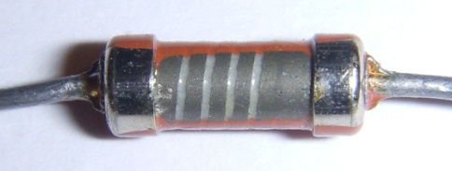
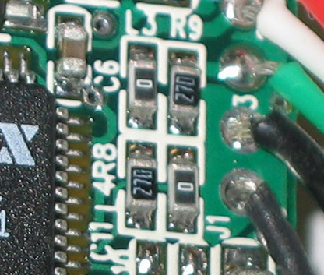
Resistors
Resistors are two-terminal devices that restrict, or resist the flow of current.
The larger the resistor the less current can flow through it for a given voltage as demonstrated by Ohm’s Law: V= I*R (Voltage = Current x Resistance)
Electrons flowing through a resistor collide with material in the resistor body, and it is these collisions that cause electrical resistance.
These collisions cause energy to be dissipated in the form of heat or light (as in a toaster or light bulb).
Resistor Symbol
Carbon Film Through
Hole Resistor
Surface Mount
Resistors

Slide 34
Resistors (2)
The amount of power (in Watts) dissipated in a resistor can be calculated using the equation, P = I*V (= I²R)
A resistor that can dissipate about 5 Watts of power would be about the size of a writing pen, and a resistor that can only dissipate 1/8 Watt is about the size of a grain of rice. If a resistor is placed in a circuit where it must dissipate more that its intended power, it will simply melt.
The physical size and appearance of a resistor is determined by the required application.
Resistors that must dissipate large amounts of energy (such as in a toaster) are relatively large, whereas resistors that dissipate small amounts of current are relatively small.
A one-ohm resistance is a relatively small value, and 100KOhm resistance is a relatively large value.

Slide 35
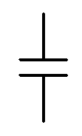
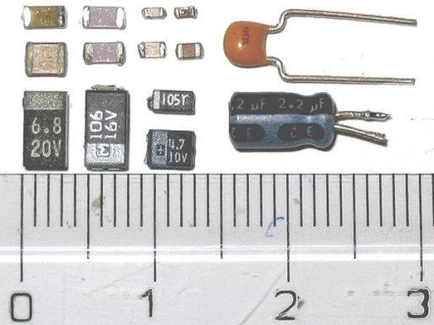
Capacitors
A capacitor is a two-terminal device that can store electric energy in the form of charged particles.
A capacitor as like a reservoir of charge that takes time to fill or empty.
The voltage across a capacitor is proportional to the amount of charge it is storing. The more charge added to a capacitor of a given size, the larger the voltage across the capacitor.
Not possible to instantly move charge to or from a capacitor, so not possible to instantly change the voltage across a capacitor. So this property makes capacitors useful on many applications.
Capacitor Symbol
SMD ceramic at top left;
SMD tantalum at bottom left;
Through-hole tantalum at top right;
Through-hole electrolytic at bottom right.
Notes:
Smaller capacitors, appearing as small blocks, disks or wafers, often have their values printed on them in an encoded manner . For these capacitors, a three-digit number typically indicates the capacitor value in picofarads. The first two digits provide the "base" number, and the third digit provides an exponent of 10 (so, for example, "104" printed on a capacitor indicates a capacitance value of 10 x 104 or 100000 pF). Occasionally, a capacitor will only show a two-digit number, in which case that number is simply the capacitor value in pF. (To be complete, if a capacitor shows a three-digit number and the third digit is 8 or 9, then the first two digits are multiplied by .01 and .1 respectively). Often, a single letter is appended to the capacitance value – this letter indicates the quality of the capacitor.

Slide 36
Capacitors (2)
Capacitance is measured in Farads.
A one-farad capacitor can store one coulomb of charge at one volt.
For engineering on a small scale (I.E., hand-held or desk-top devices), a one-farad capacitor stores far too much charge to be of general use. (It would be like a car having a 1000 gallon petrol tank).
More useful capacitors are measured in micro-farads (µF) or pico-farads (pF). (µ is pronounced, ‘meew’)
The terms "milli-farad“ and "nano-farad" are rarely used. Large capacitors often have their value printed plainly on them, such as "10 µF" (for 10 microfarads).

Slide 37
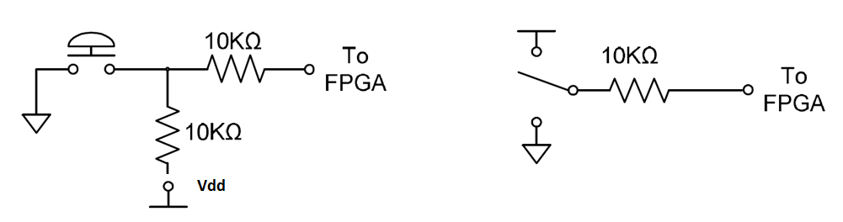
Input Devices (Buttons and Switches)
Input devices like buttons and switches should be able to produce Vdd or GND based on some user action.
The slide switches are also known as “single throw-double pole” (STDP) switches, because only one switch (or throw) exists, but two positions (or poles) are available.
The push button switches are “momentary” contact buttons.
Push Button Switch STDP Switch
Notes:
Circuits often require inputs that come directly from users (as opposed to inputs that come from other devices). User-input devices can take many forms, among them keyboards (as on a PC), buttons (as on a calculator or telephone), rotary dials, switches and levers, etc.

Slide 38
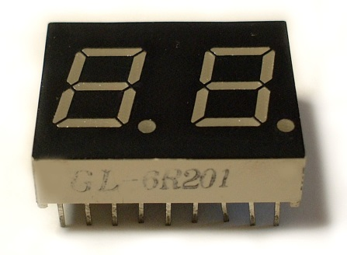
Output Devices
These include computer monitors, LCD alphanumeric panels (as on a calculator), small lamps or light-emitting diodes (LEDs).
Typical demo boards include some number of individual LEDs, and seven-segment LED displays that can display the digits 0-9 in each digit position (each segment in the seven-segment display contains a single LED).
LED's are two-terminal semiconductor devices (diodes) that conduct current in only one direction (from the anode to the cathode).
Seven-Segment LED

Slide 39
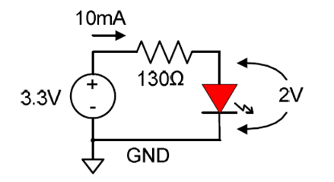
Output Devices (2)
LED chips are secured inside a plastic housing, and they emit light at a given frequency (RED, YELLOW, etc.) when a small electric current (typically 10mA to 25mA) flow through them.
LEDs will not turn on unless their anodes are some minimal voltage above their cathodes, typically about two volts. If less than the minimum threshold voltage is applied to an LED, it will remain dark.
LED requires a 2V drop to turn on, leaving 1.3V to drop across the resistor. Thus, a 130 ohm resistor is required to cause 10mA of current to flow in the circuit (3.3V – 2V = 1.3V and 1.3V / 130 ohms = 10mA).

Slide 40
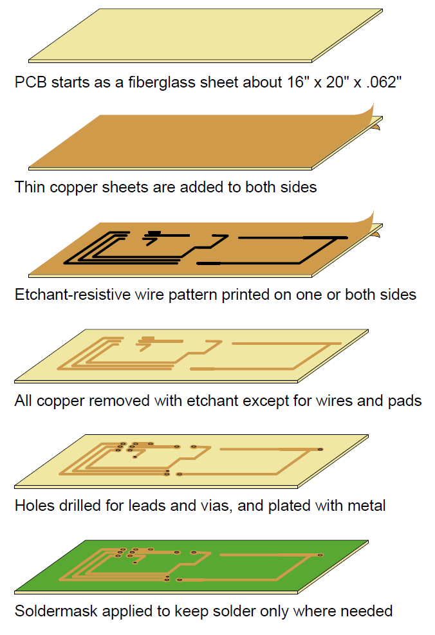
Printed Circuit Board
The flat surface known as PCB (Printed Circuit Board)
Two broad categories:
prototype or experimental circuits (breadboards or proto-boards);
production and/or commercial sale.
Production circuit boards design is done using CAD software (E.G. OrCAD, Protel, etc...).
Notes:
Electronic components are often assembled and interconnected on a flat surface known as a circuit board.
The several types of existing circuit boards may be divided into two broad categories:
those intended for prototype or experimental circuits;
and those intended for production and/or commercial sale.
Circuit boards used for experimental work are often referred to as breadboards or protoboards.
Production circuit boards are design usually using specialised CAD software (e.g. OrCAD, Protel, etc..). Once the design is completed, the PCB has to be manufactured. Typical steps are shown in the picture.

Slide 41
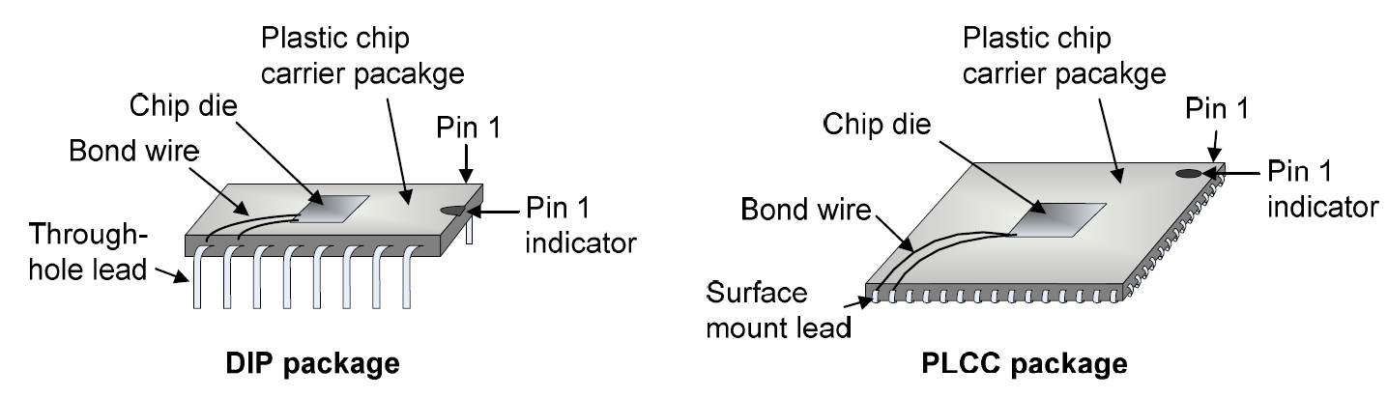
Integrated Circuits
Semiconductor circuits that use collections microscopic transistors that are all co-located on the same small piece of silicon. Represented with “U” on schematics or PCBs.
Various functions from simple logic to highly complex processing functions.
Some chips contain just a handful of transistors, while others contain several hundred million transistors (E.G. Intel processors).
Dual In-line Package vs Plastic Leaded Chip Carrier
Notes:
As shown in the figures, the chips themselves are much smaller than their packages. During
manufacturing, the small, fragile chips are glued (using epoxy) onto the bottom half of the package,
bond-wires are attached to the chip and to the externally available pins, and then the top half of the
chip package is permanently affixed. Smaller chips may only have a few pins, but larger chips can
have more than 500 pins. Since the chips themselves are on the order of a centimetre on each side,
very precise and delicate machines are required to mount them in their packages.
Smaller chips might be packaged in a "DIP" package (DIP is an acronym for Dual In-line Package) as
shown below. Typically on the order of 1" x 1/4", DIP packages are most often made from black plastic, and they can have anywhere from 8 to 48 pins protruding in equal numbers from either side.
DIPs are used exclusively in through-hole processes. Larger chips use many different packages – one
common package, the "PLCC" (for Plastic Leaded Chip Carrier) is shown. Since these larger
packages can have up to several hundred pins, it is often not practical to use the relatively large leads
required by through-hole packages. Thus, large chips usually use surface mount packages, where the
external pins can be smaller and more densely packed.

Slide 42
Digital Circuits
A digital circuit represents and manipulates information encoded as electric signals that can assume one of two Vdd or GND.
If a given circuit net is at Vdd, then that signal is said to carry a logic ‘1’; if the net is at GND, then the node carries a logic ‘0’ [More on Logic 1 and 0 in a couple of weeks]
The components in digital circuits are simple on/off switches that can pass logic ‘1’ and logic ‘0’ signals from one circuit net to another.
Most typically, these switches are arranged to combine input signals to produce an output signal according to basic logic relationships.
Notes:
Using just switches and resistors, it is also possible to create logical circuits that perform compound logical relationships, like “F = (A and B) or C”.

Slide 43
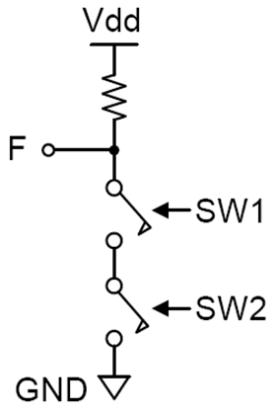
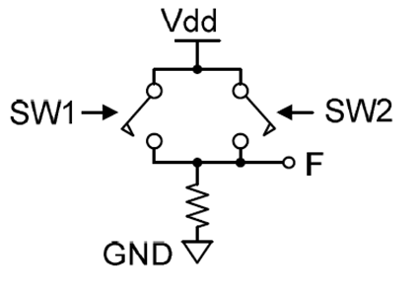
Digital Circuits (2)
Assuming a logic ‘1’ is closing the switch and a logic ‘0’ opens the switch, in the example the combination of switches can implement logic functions.
One well-known logic circuit is an NAND gate that combines two input signals to produce an output that is the logic NAND (negative AND) of the inputs (i.e., if both input1 and input2 are a ‘1’, then the output is a ‘0’).
Another well-known logic circuit is OR gate that combines two input signals to produce an output that is the logic OR of the inputs (I.E. if input1 or input2 are ‘1’, then the output is a ‘1’)

Slide 44
Transistors
…. are switches!!!
Transistors are arranged so that they can be turned on or off by signals carrying either Vdd or GND.
The transistor switches used in modern digital circuits are called “Metal Oxide Semiconductor Field Effect Transistors”, or MOSFETs (or just FETs).
FETs are three-terminal devices that can conduct current between two terminals (the source and the drain) when a third terminal (the gate) is driven by an appropriate logic signal.
Notes:
Of course, when the gate voltage changes from Vdd to GND or vice-versa, it must necessary assume voltages between Vdd and GND – we assume that this happens infinitely fast, so that we can ignore FET characteristics during the time the gate voltage is switching.

Slide 45
Transistors (2)
In the simplest FET model (which is appropriate for our use here), the electrical resistance between the source and the drain is a function of the gate-to-source voltage.
The higher the gate voltage, the lower the resistance (and therefore, the more current that can flow).
In analog circuits (like audio amplifiers), the gate-to-source voltage is allowed to assume any voltage between GND and Vdd.
In digital circuits, though, the gate-to-source voltage is constrained to be either Vdd or GND.

Slide 46
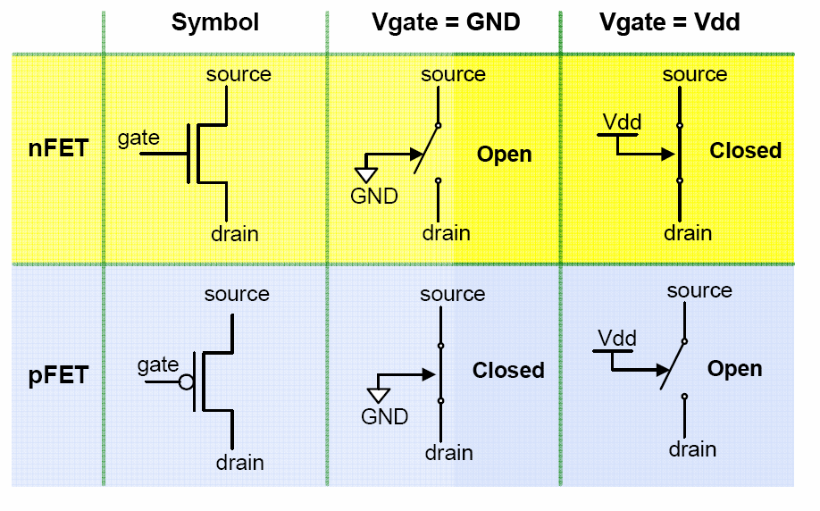
Transistors (3)
FETs can be thought as electrically controllable “ON/OFF” switches.
nFETs normally open, pFETs normally closed
Notes:
In a simple digital model, FETs can be thought of as electrically controllable "on/off" switches. An electrical connection is created between the
source and the drain (i.e., the FET is turned “on”) when the gate input is asserted. One kind of FET, called an nFET, is turned on when Vdd is present
at the control input, and a second type, called a pFET, is turned on when GND is present at the control input. Thus, an "asserted" input for an nFET means that
the control signal is at Vdd, and for a pFET means the control input is at a GND. The figures show the circuit symbols and equivalent switch diagrams for both nFETs and pFETs.

Slide 47
More on Integrated Circuits
FETs can also be arranged into circuits that perform useful logic functions such as AND, OR, NOT, etc.
Several very small FETs are constructed on a single small piece of silicon (or chip of silicon) and then interconnected with equally small metal wires.
These microscopic FETs are typically implemented using geometries in the region of 90, 60, 45, 28 or 20 nanometres.
Since a silicon chip might measure several millimeters on a side, several millions of FETs can be constructed on a single chip.
Circuits assembled in this fashion are said to form "integrated circuits" (or IC’s), because all circuit components are constructed and integrated on the same piece of silicon.

Slide 48
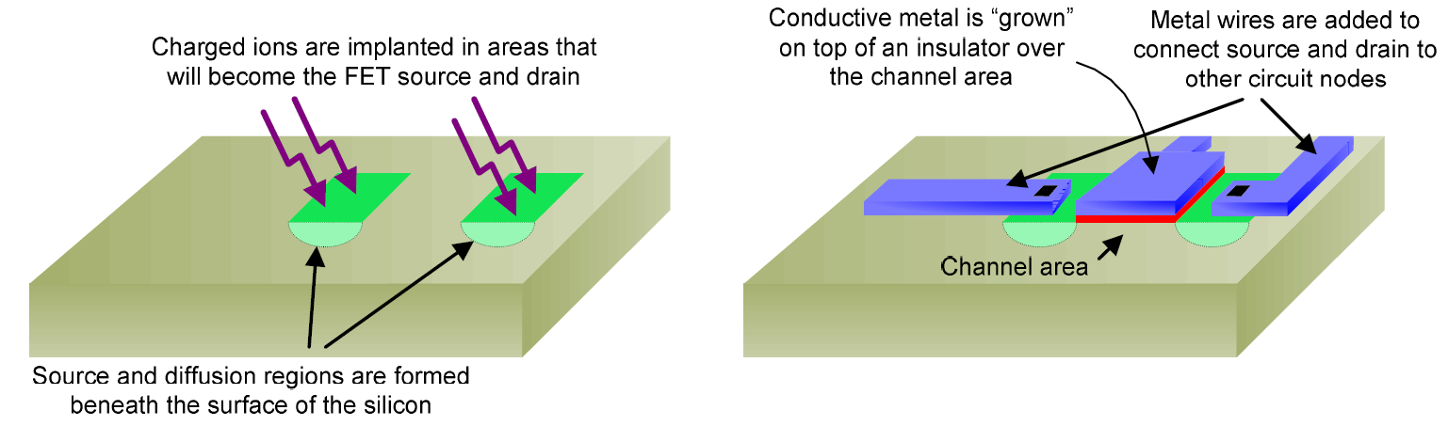
FETs Manufacturing
Ions implant to make silicon chip more conductive in the FET source and the drain regions – called diffusion regions.
A thin insulating layer is created between these diffusion regions, and another conductor is "grown" on top of this insulator.
The grown conductor (typically silicon) forms the gate, and the area immediately under the gate and between the diffusion regions is called the channel.
Finally, metal wires are connected to the source, drain, and gate structures so that the FET can be connected in a larger circuit.
Notes:
A silicon chip is implanted with ions to make it more conductive in the areas that will become the FET source and the drain regions – called diffusion regions
A thin insulating layer is created between these diffusion regions, and another conductor is "grown" on top of this insulator
This grown conductor (typically silicon) forms the gate, and the area immediately under the gate and between the diffusion regions is called the channel. Finally, wires are connected to the source, drain, and gate structures so that the FET can be connected in a larger circuit.

Slide 49
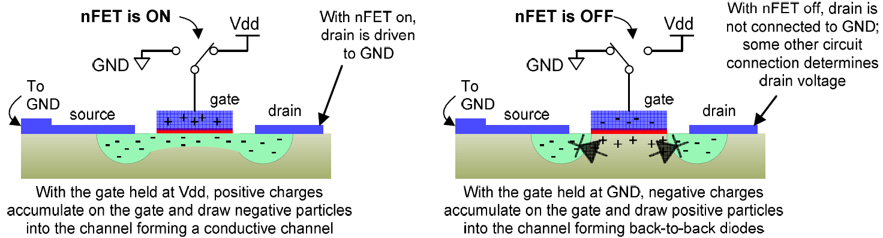
FETs – Principle of Operation
If the voltage on the gate >= the threshold voltage (about 0.5V), positive charges begin to accumulate on the gate and positive charges in the channel region immediately under the gate are repelled. A net negative charge accumulates under the gate, forming a channel of continuous conductive region in the area under the gate and between the source and drain diffusion areas. When the gate voltage reaches Vdd, a large conductive channel forms and the nFET is “strongly” on.
Notes:
The basic principles of FET operation are actually quite straightforward. The discussion applies only to nFETs; pFET operation is entirely similar. but the voltages must be reversed.
Both the source and drain diffusion areas of an nFET are implanted with negatively charged particles. When an nFET is used in a logic circuit, its source lead is connected to GND, so that the nFET source, like the GND node, has an abundance of negatively charged particles.
If the gate voltage of an nFET is at the same voltage as the source lead (i.e., GND), then the presence of the negatively charged particles on the gate repels negatively charged particles from the channel region immediately under the gate (note that in semiconductors such as silicon, positive and negative charges are mobile and can move about the semiconductor lattice under the influence of charged-particle induced electric fields). A net positive charge accumulates under the gate, and two back-to-back positive-negative junctions of charge (called pn junctions) are formed. These pn junctions prevent current flow in either direction.
If the voltage on the gate is raised above the source voltage by an amount exceeding the threshold voltage (or Vth, which equals about 0.5V), positive charges begin to accumulate on the gate and positive charges in the channel region immediately under the gate are repelled. A net negative charge accumulates under the gate, forming a channel of continuous conductive region in the area under the gate and between the source and drain diffusion areas. When the gate voltage reaches Vdd, a large conductive channel forms and the nFET is “strongly” on.

Slide 50
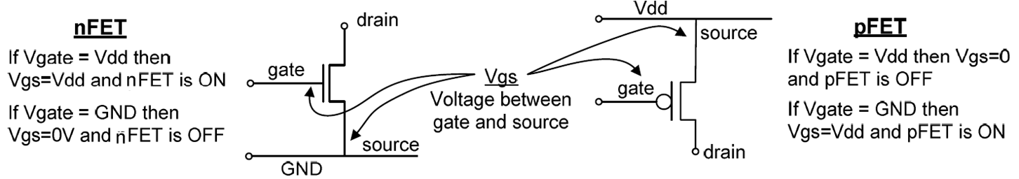
FETs Summary
nFETs used in logic circuits have their source leads attached to GND and Vdd on their gate turns them on.
pFETs have their source leads attached to Vdd and GND on their gate turns them on.

Slide 51
Rules for Digital Logic Circuits with FETs
pFET sources must be connected to Vdd and nFET sources must be connected to GND.
The circuit output must never be left floating.
The logic circuit output must never be connected to both Vdd and GND at the same time.
I.E., the circuit output must not be “shorted”.
The circuit must use the fewest possible number of FETs.

Slide 52
End of Computers and Electricity
That describes the relationship between electricity and computer circuitry.
We went back to first principles of electricity to look at the nature of electrons in the field of Physics. We moved through the means by which electrical circuits can be utilised on microelectronic devices – specifically integrated circuits.
Are there…
ANY QUESTIONS?

Slide 53
Where to Next?
NEXT TIME:
The theme of the next lecture:
“Number Bases”
What are the number bases of binary, octal and hexadecimal? How are they related to computer operation? We can look at these things next.

Slide 54
Thanks for your attentiveness.
See you here next time. Be safe and well in the meantime.

